Slide 1
Errors and Cancellation

Slide 2
My daughter, Julia, is planning her b-day party, and she decided she wants to have a slime theme. Her slime recipe asks for 0.4lb of glue, unfortunately I do not have any scale that can measure such small weight. She told me that if she cannot measure the glue accurately, her party will be a complete disaster!
Julia asked me if we can use the same technique that I use when measuring my suitcase weight before trips: I climb on the scale holding the suitcase, and then again without it, subtract both weights, and voila, I have the weight of the suitcase! My digital scale has readings with resolution of 0.1lb (this is the increment), and according to the manual, it gives measurements with up to 1% relative error.
What do you think I should do? Follow her advice, or immediately go to Amazon and order a small kitchen scale (and make sure I avoid unpleasant surprises during the party)?

Slide 3
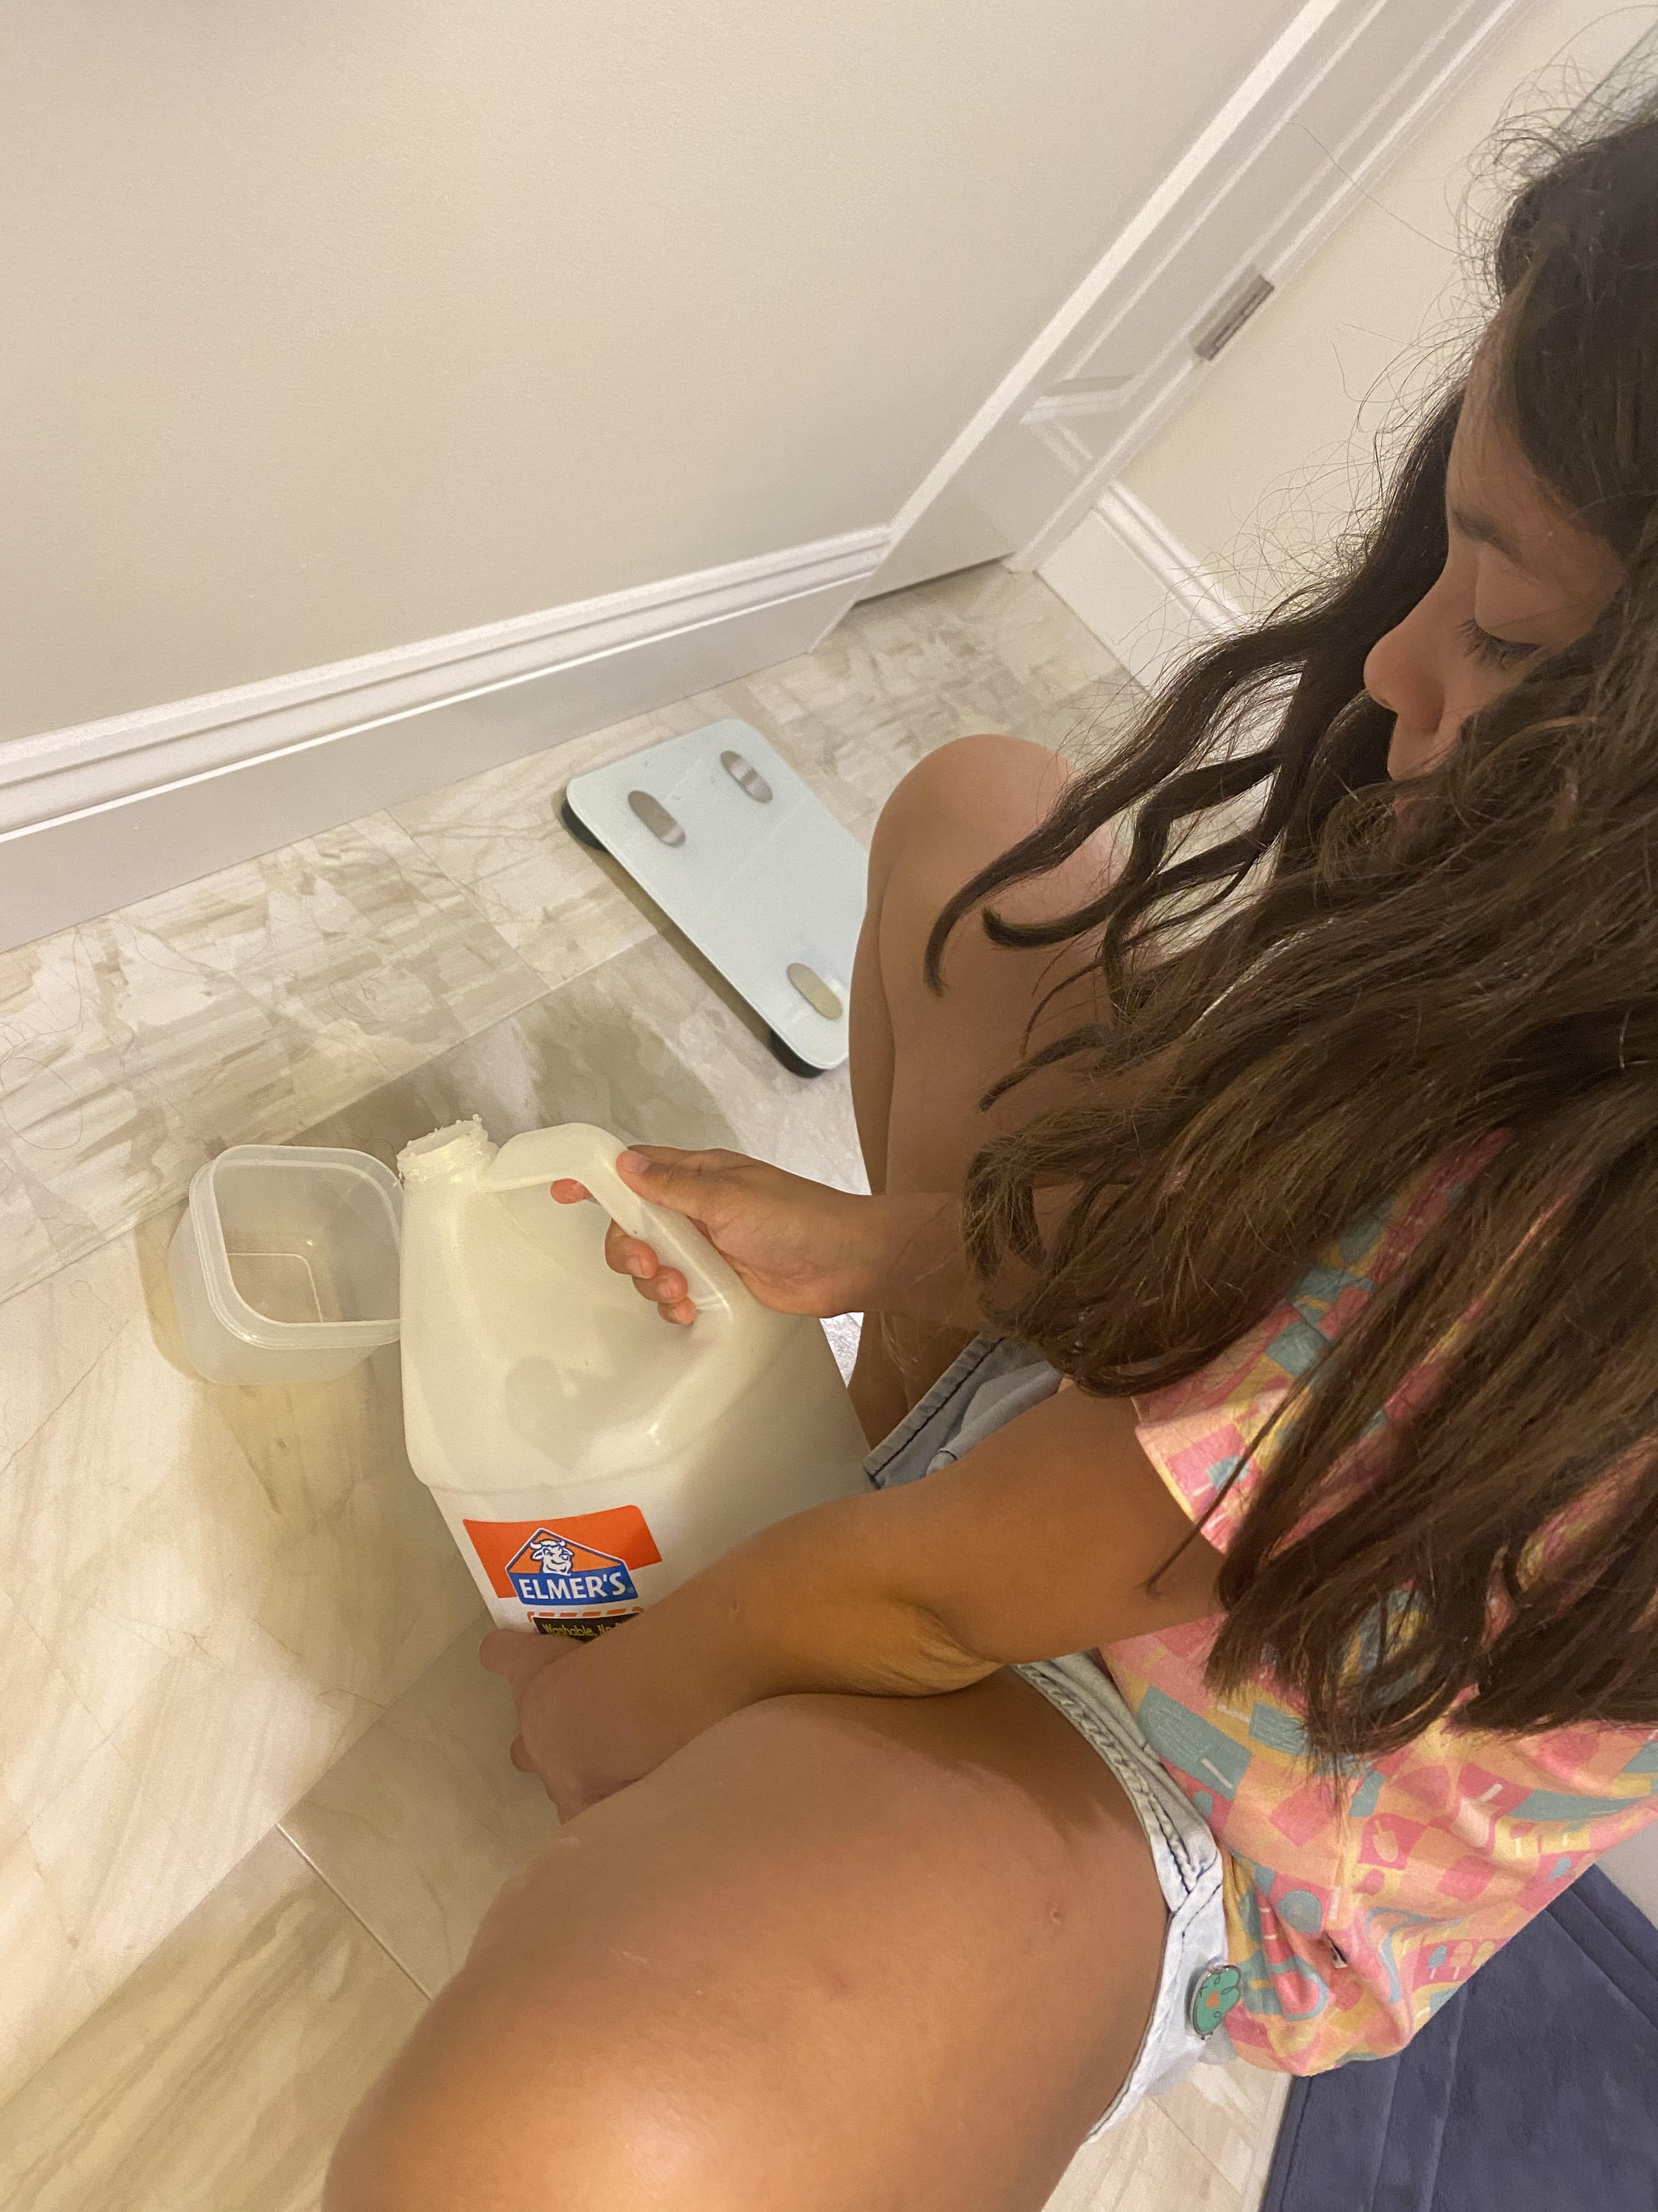

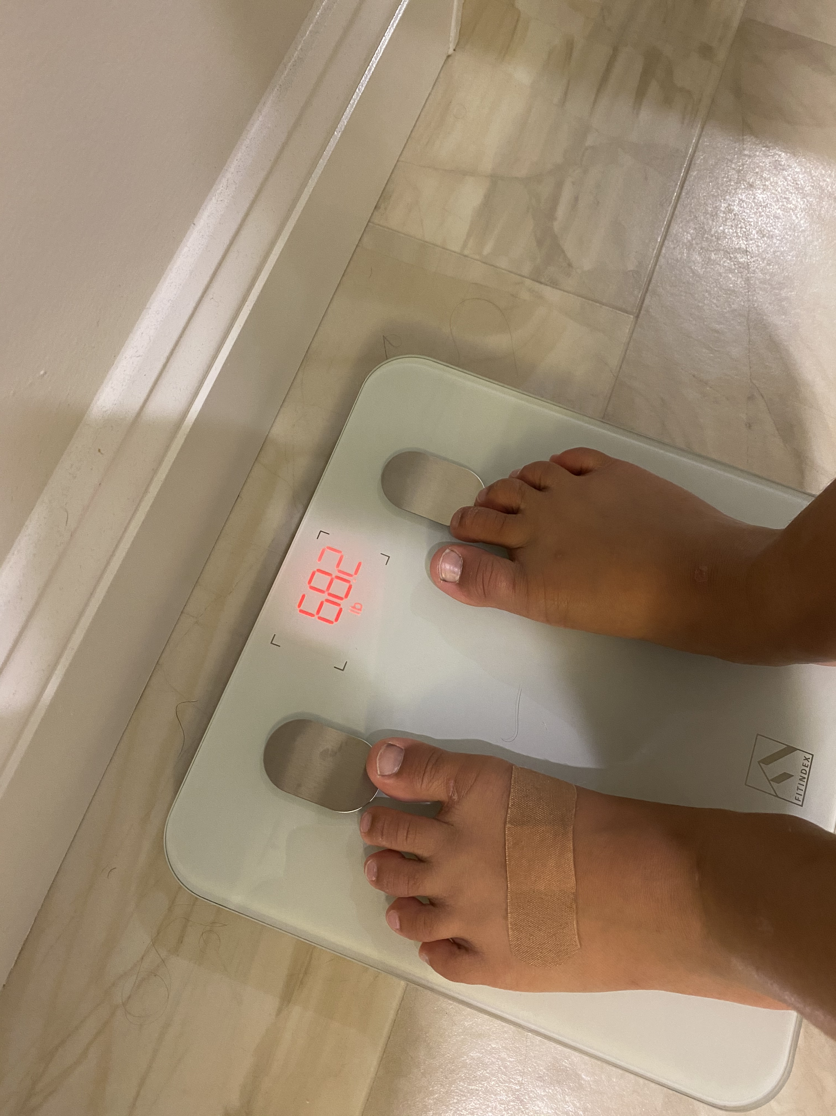
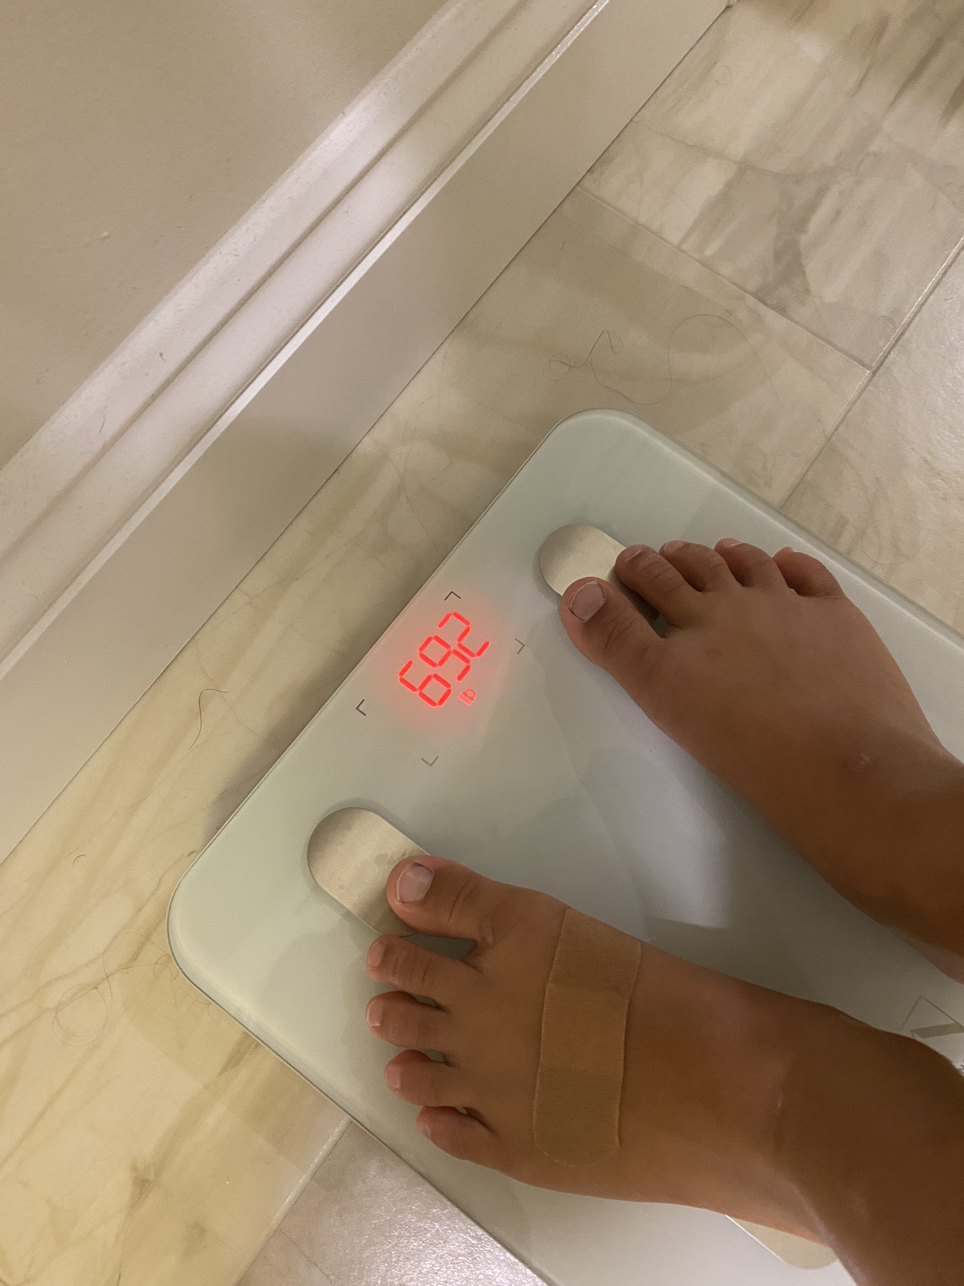

Slide 4
Video 1: Intro to Floating point

Slide 5
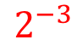
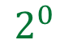
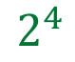
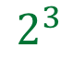
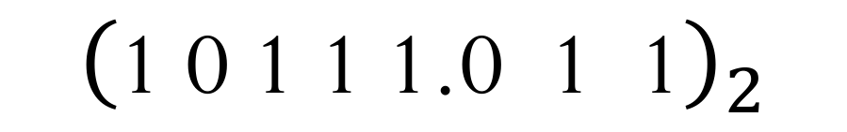
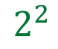
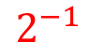
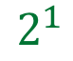
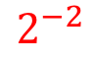
(Unsigned) Fixed-point representation
The numbers are stored with a fixed number of bits for the integer part and a fixed number of bits for the fractional part.
Suppose we have 8 bits to store a real number, where 5 bits store the integer part and 3 bits store the fractional part:
$${\left(\text{1} \text{0} \text{1} \text{1} \text{1.0} \text{1}\text{ 1}\right)}_{2}$$
$$2^{4}$$
$$2^{3}$$
$$2^{2}$$
$$2^{1}$$
$$2^{0}$$
$$2^{−1}$$
$$2^{−2}$$
$$2^{−3}$$
Smallest number:
Largest number:

Slide 6
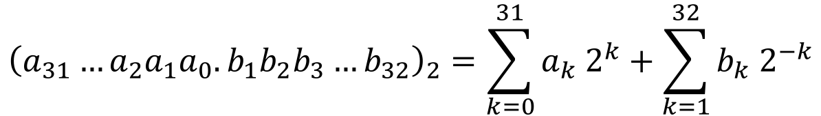
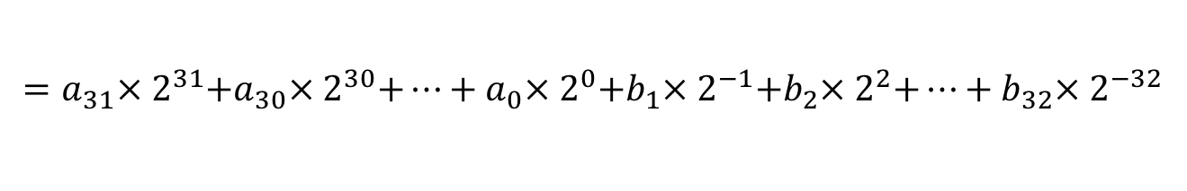
(Unsigned) Fixed-point representation
Suppose we have 64 bits to store a real number, where 32 bits store the integer part and 32 bits store the fractional part:
Smallest number:
Largest number:
$${\left(a_{31}…a_{2}a_{1}a_{0}.b_{1}b_{2}b_{3}…b_{32}\right)}_{2}=\sum_{k=0}^{31}{a_{k}{ 2}^{k}}+\sum_{k=1}^{32}{b_{k}{ 2}^{−k}}$$
$$=a_{31}×{ 2}^{31}+a_{30}×{ 2}^{30}+…+a_{0}×{ 2}^{0}+b_{1}×{ 2}^{−1}+b_{2}×{ 2}^{2}+…+b_{32}×{ 2}^{−32}$$

Slide 7
Fixed-point representation
How can we decide where to locate the binary point?
More bits on the integer part?
More bits on the fractional part?

Slide 8
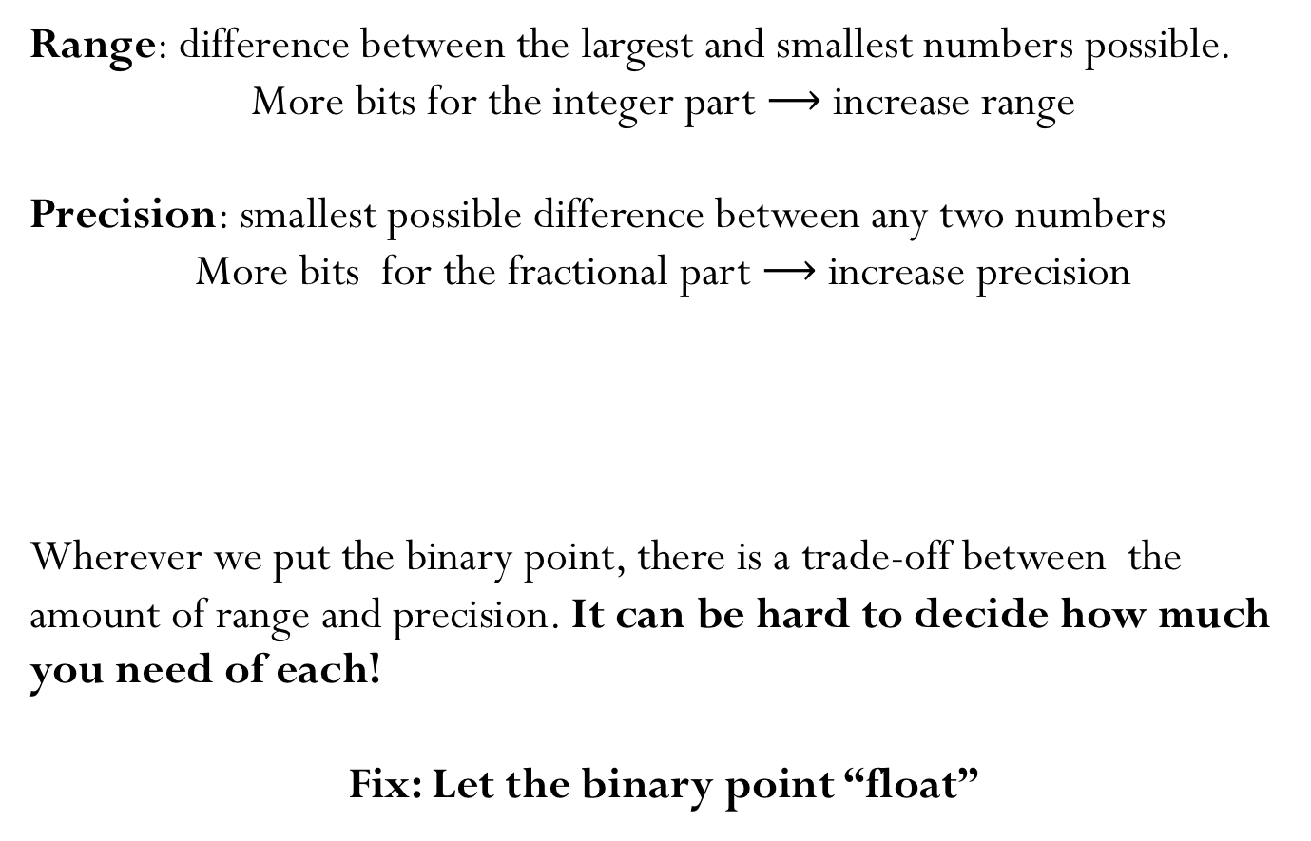
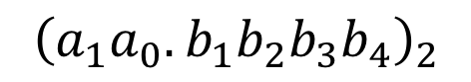
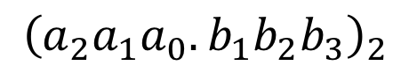
(Unsigned) Fixed-point representation
Range: difference between the largest and smallest numbers possible.
More bits for the integer part $⟶$ increase range
Precision: smallest possible difference between any two numbers
More bits for the fractional part $⟶$ increase precision
Wherever we put the binary point, there is a trade-off between the amount of range and precision. It can be hard to decide how much you need of each!
Fix: Let the binary point “float”
$${\left(a_{2}a_{1}a_{0}.b_{1}b_{2}b_{3}\right)}_{2}$$
OR
$${\left(a_{1}a_{0}.b_{1}b_{2}b_{3}b_{4}\right)}_{2}$$

Slide 9
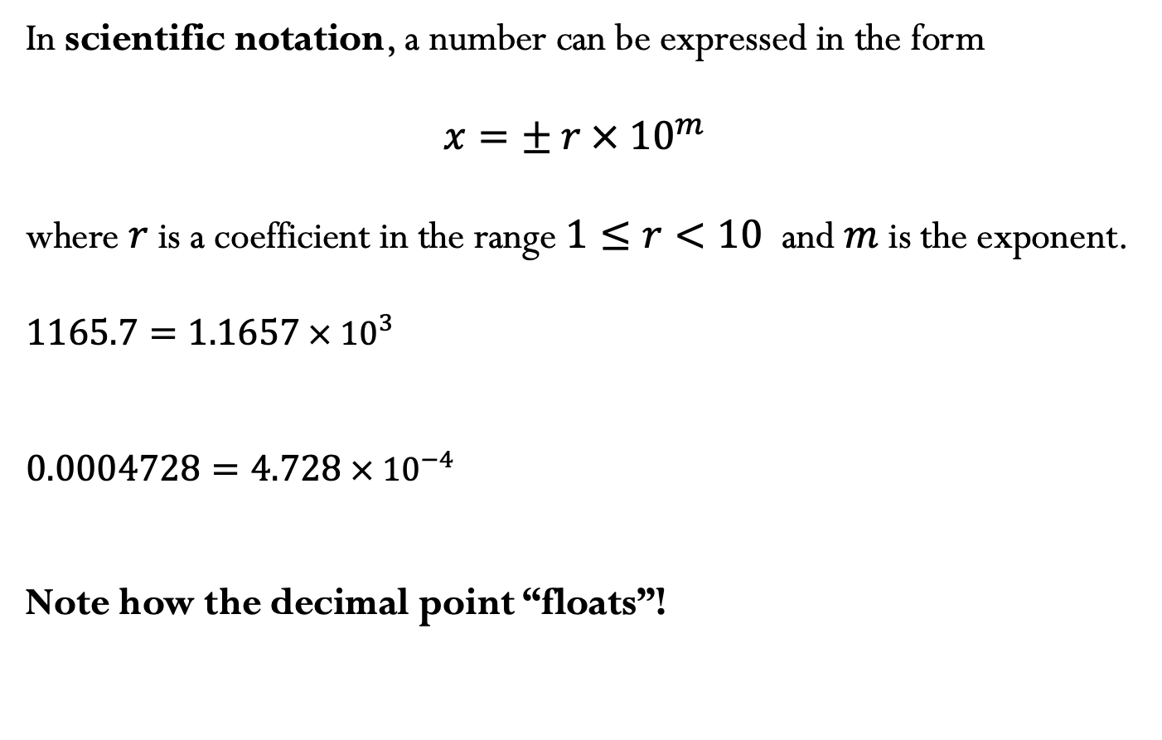
Scientific Notation
In scientific notation, a number can be expressed in the form
$$x=± r ×{ 10}^{m}$$
where $r$is a coefficient in the range $1≤r<10$ and $m$ is the exponent.
$$1165.7=1.1657 ×{ 10}^{3}$$
$$0.0004728=4.728 ×{ 10}^{−4}$$
Note how the decimal point “floats”!

Slide 10
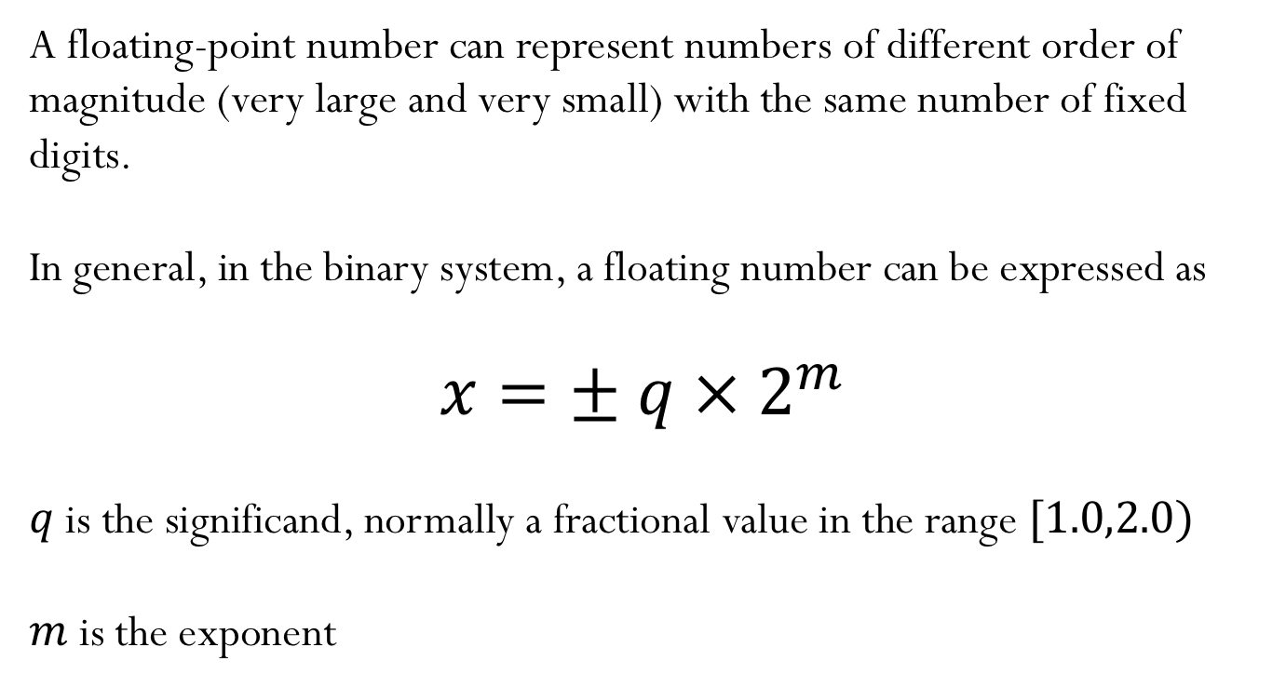
Floating-point numbers
A floating-point number can represent numbers of different order of magnitude (very large and very small) with the same number of fixed digits.
In general, in the binary system, a floating number can be expressed as
$$x=± q ×{ 2}^{m}$$
$q$is the significand, normally a fractional value in the range $[1.0,2.0)$
$m$ is the exponent

Slide 11
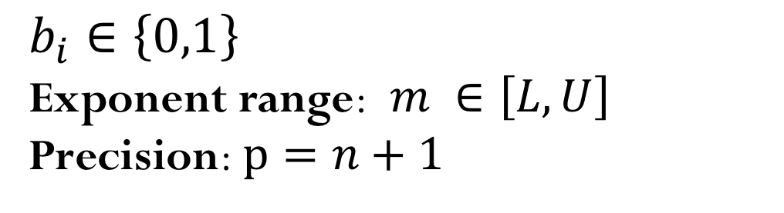
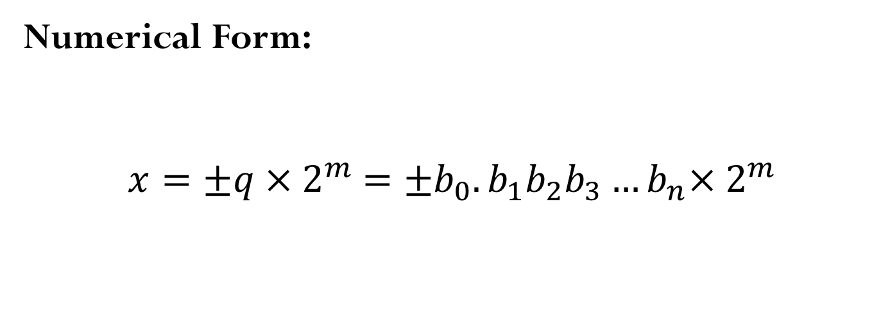
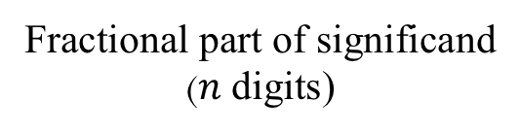
Floating-point numbers
Numerical Form:
$$x=±q ×{ 2}^{m} =±b_{0}.b_{1}b_{2}b_{3}…b_{n}×{ 2}^{m}$$
Fractional part of significand
($n$ digits)
$$b_{i}∈\left\{0,1\right\}$$
Exponent range:$m ∈\left[L,U\right]$
Precision: $p=n+1$

Slide 12
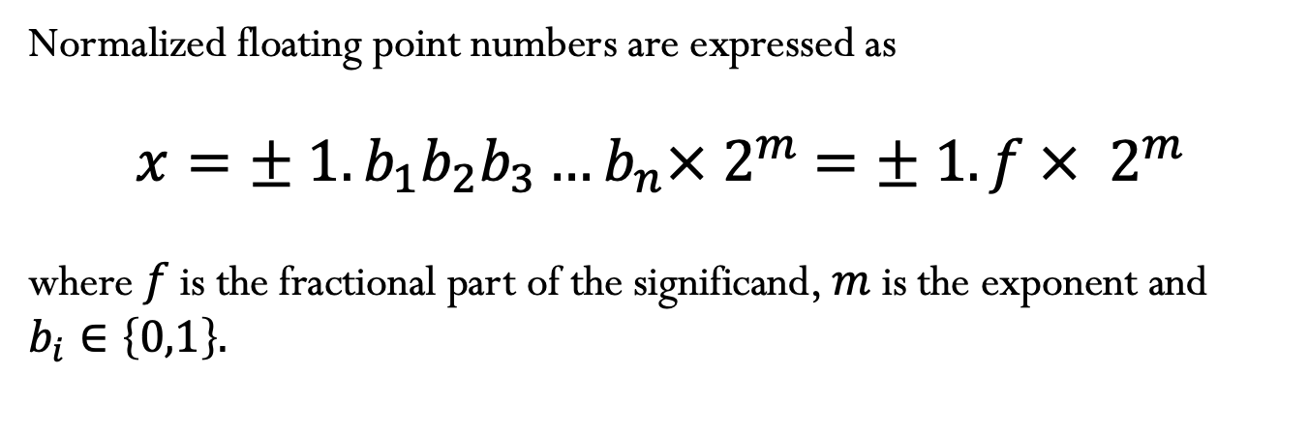
Normalized floating-point numbers
Normalized floating point numbers are expressed as
$$x=± 1.b_{1}b_{2}b_{3}…b_{n}×{ 2}^{m} =± 1.f ×{ 2}^{m}$$
where $f$ is the fractional part of the significand, $m$ is the exponent and $b_{i}∈\left\{0,1\right\}.$

Slide 13
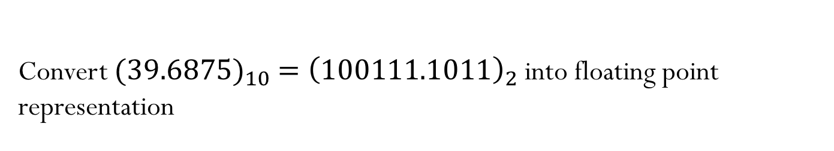
Converting floating points
Convert ${{(39.6875)}_{10} =\left(100111.1011\right)}_{2}$ into floating point representation

Slide 14
Video 2: Normalized floating point representation

Slide 15
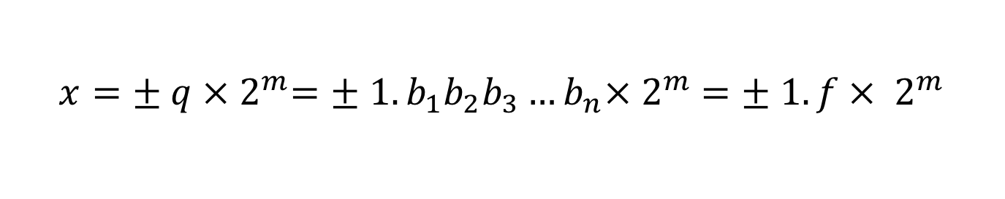
Normalized floating-point numbers
$$x=± q ×{ 2}^{m}=± 1.b_{1}b_{2}b_{3}…b_{n}×{ 2}^{m} =± 1.f ×{ 2}^{m}$$
Exponent range:
Precision:
Smallest positive normalized FP number:
Largest positive normalized FP number:
Notes:
Note that The value UFL and OFL depend on the exponent range

Slide 16
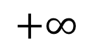
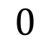
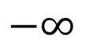
Normalized floating point number scale
$$−∞$$
$$+∞$$
$$0$$

Slide 17
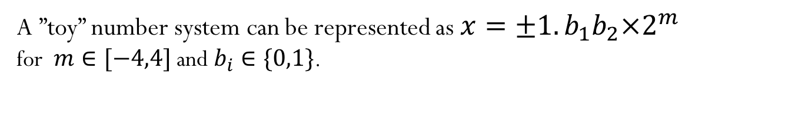
Floating-point numbers: Simple example
A ”toy” number system can be represented as $x=±1.b_{1}b_{2}×2^{m}$
for $m∈[−4,4]$ and $b_{i}∈\{0,1\}$.

Slide 18
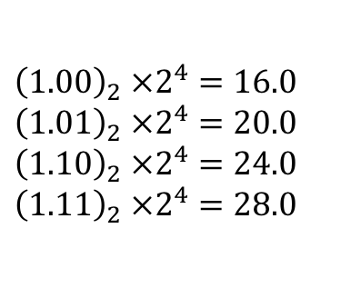
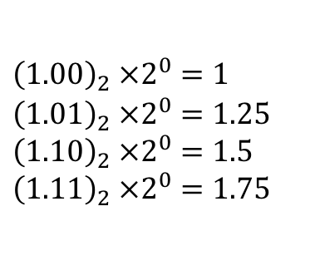
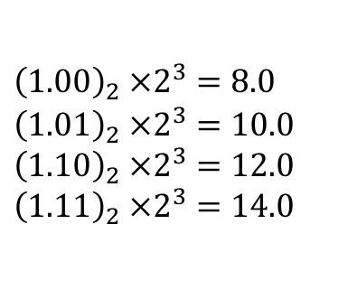
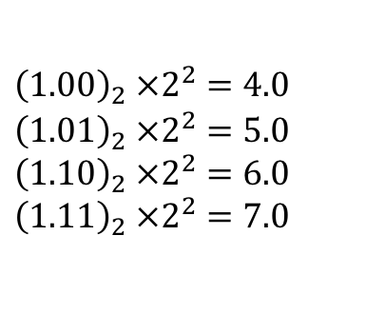
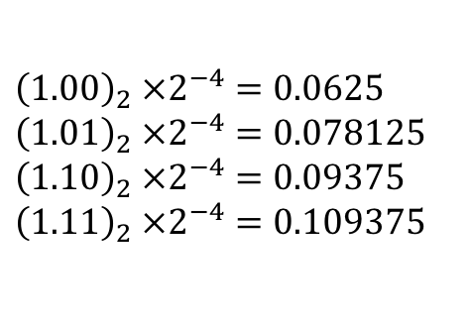
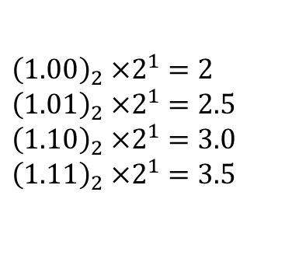
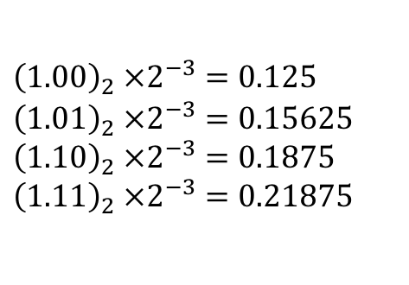
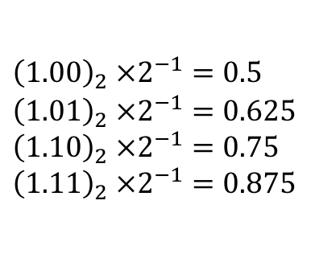
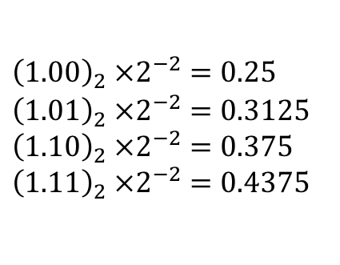
Floating-point numbers: Simple example
A ”toy” number system can be represented as $x=±1.b_{1}b_{2}×2^{m}$
for $m∈[−4,4]$ and $b_{i}∈\{0,1\}$.
$${\left(1.00\right)}_{2} ×2^{0}=1$$
$${\left(1.01\right)}_{2} ×2^{0}=1.25$$
$${\left(1.10\right)}_{2} ×2^{0}=1.5$$
$${\left(1.11\right)}_{2} ×2^{0}=1.75$$
$${\left(1.00\right)}_{2} ×2^{1}=2$$
$${\left(1.01\right)}_{2} ×2^{1}=2.5$$
$${\left(1.10\right)}_{2} ×2^{1}=3.0$$
$${\left(1.11\right)}_{2} ×2^{1}=3.5$$
$${\left(1.00\right)}_{2} ×2^{2}=4.0$$
$${\left(1.01\right)}_{2} ×2^{2}=5.0$$
$${\left(1.10\right)}_{2} ×2^{2}=6.0$$
$${\left(1.11\right)}_{2} ×2^{2}=7.0$$
$${\left(1.00\right)}_{2} ×2^{3}=8.0$$
$${\left(1.01\right)}_{2} ×2^{3}=10.0$$
$${\left(1.10\right)}_{2} ×2^{3}=12.0$$
$${\left(1.11\right)}_{2} ×2^{3}=14.0$$
$${\left(1.00\right)}_{2} ×2^{4}=16.0$$
$${\left(1.01\right)}_{2} ×2^{4}=20.0$$
$${\left(1.10\right)}_{2} ×2^{4}=24.0$$
$${\left(1.11\right)}_{2} ×2^{4}=28.0$$
$${\left(1.00\right)}_{2} ×2^{−1}=0.5$$
$${\left(1.01\right)}_{2} ×2^{−1}=0.625$$
$${\left(1.10\right)}_{2} ×2^{−1}=0.75$$
$${\left(1.11\right)}_{2} ×2^{−1}=0.875$$
$${\left(1.00\right)}_{2} ×2^{−2}=0.25$$
$${\left(1.01\right)}_{2} ×2^{−2}=0.3125$$
$${\left(1.10\right)}_{2} ×2^{−2}=0.375$$
$${\left(1.11\right)}_{2} ×2^{−2}=0.4375$$
$${\left(1.00\right)}_{2} ×2^{−3}=0.125$$
$${\left(1.01\right)}_{2} ×2^{−3}=0.15625$$
$${\left(1.10\right)}_{2} ×2^{−3}=0.1875$$
$${\left(1.11\right)}_{2} ×2^{−3}=0.21875$$
$${\left(1.00\right)}_{2} ×2^{−4}=0.0625$$
$${\left(1.01\right)}_{2} ×2^{−4}=0.078125$$
$${\left(1.10\right)}_{2} ×2^{−4}=0.09375$$
$${\left(1.11\right)}_{2} ×2^{−4}=0.109375$$
Same steps are performed to obtain the negative numbers. For simplicity, we will show only the positive numbers in this example.

Slide 19
$x=±1.b_{1}b_{2}×2^{m}$ for $m∈[−4,4]$ and $b_{i}∈\{0,1\}$
Smallest normalized positive number:
Largest normalized positive number:
Notes:
There are some other definitions for machine epsilon, which give ½ times this number, but we will not discuss them, or use them in this class. You can check textbook and online references if you want to read more about machine epsilon

Slide 20
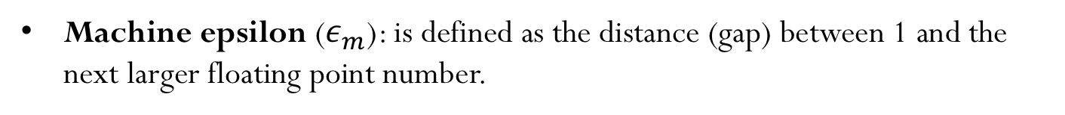
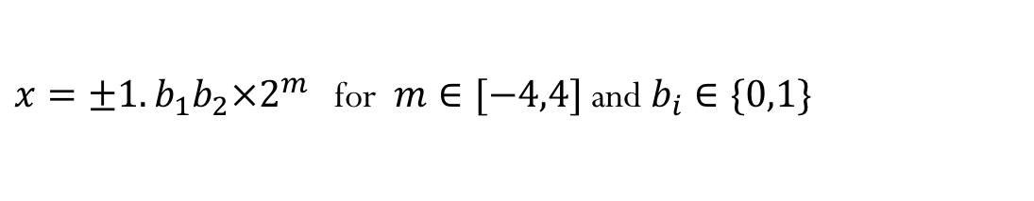
Machine epsilon
Machine epsilon ($ε_{m}$): is defined as the distance (gap) between 1 and the next larger floating point number.
$x=±1.b_{1}b_{2}×2^{m}$ for $m∈[−4,4]$ and $b_{i}∈\{0,1\}$
Notes:
There are some other definitions for machine epsilon, which give ½ times this number, but we will not discuss them, or use them in this class. You can check textbook and online references if you want to read more about machine epsilon.
The value of machine epsilon does not depend on the exponent range, but instead it depends on the number of digits on the significand

Slide 21
Range of integer numbers
Suppose you have this following normalized floating point representation:
$x=±1.b_{1}b_{2}×2^{m}$ for $m∈[−4,4]$ and $b_{i}∈\{0,1\}$
What is the range of integer numbers that you can represent exactly?

